Slide 1
MPA Project – Image Morphing Using Delaunay Triangulation (Submitted Dr. Anukriti Bansal) 6th Semester
By - Rivanshu Goyal (17UCS132) Daksh Balyan (17UCS049)

Slide 2
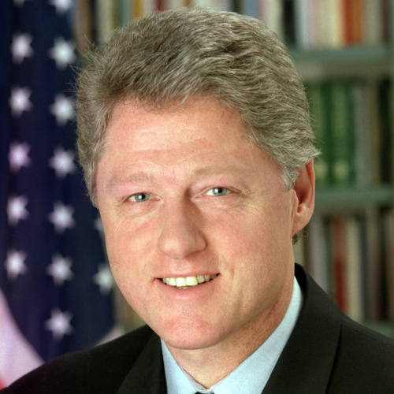
“Clinton.jpg” Starting Image

Slide 3
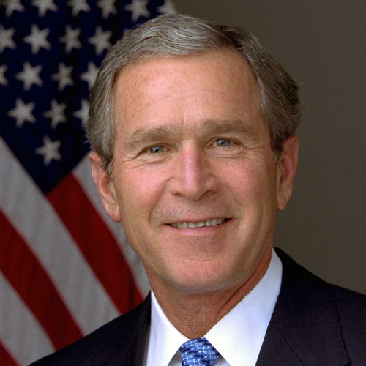
“Bush.jpg” Final Image

Slide 4
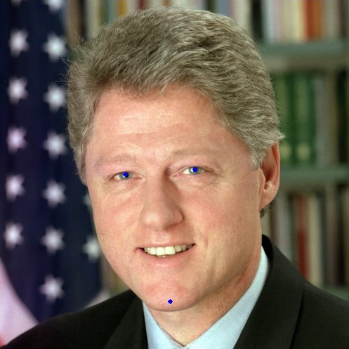
“Clinton.jpg” image with 3 control points

Slide 5

“Bush.jpg” image with 3 control points

Slide 6
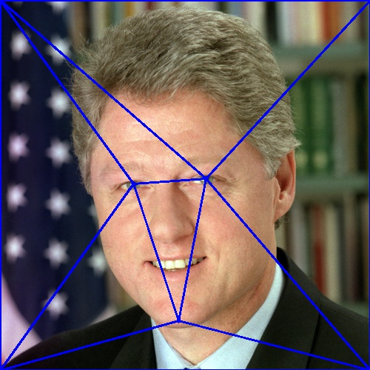
Clinton Image After Delaunay Triangulation

Slide 7
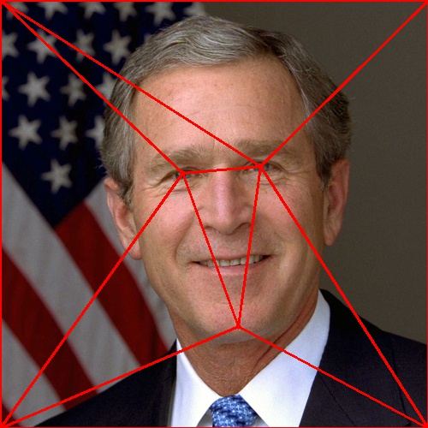
Bush Image After Delaunay Triangulation

Slide 8

1st Frame – Initial Image

Slide 9
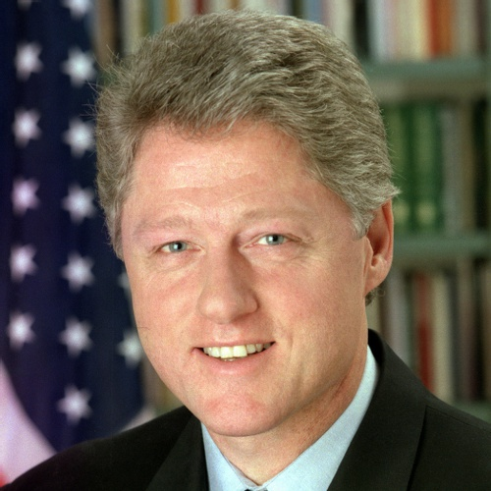
2nd Frame

Slide 10
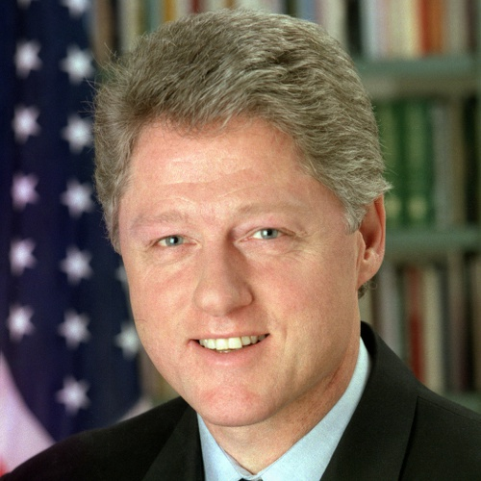
3rd Frame

Slide 11
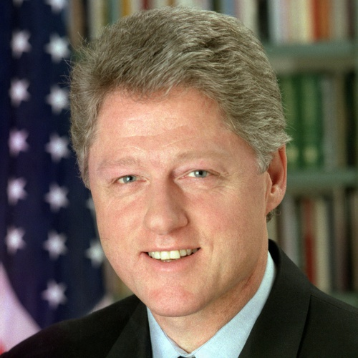
4th Frame

Slide 12

5th Frame

Slide 13

6th Frame

Slide 14
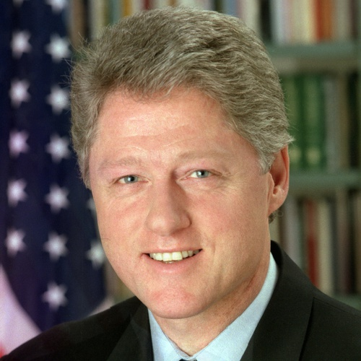
7th Frame

Slide 15
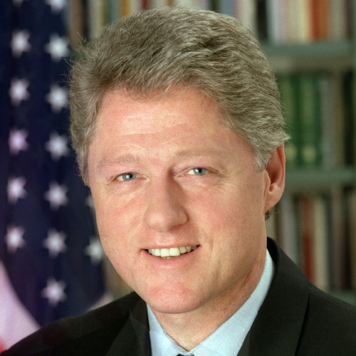
8th Frame

Slide 16
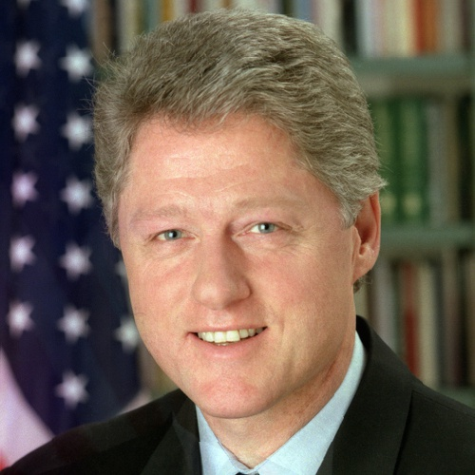
9th Frame

Slide 17

10th Frame

Slide 18

11th Frame

Slide 19
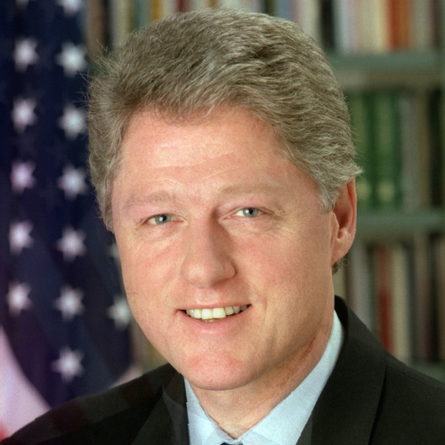
12th Frame

Slide 20

13th Frame

Slide 21

14th Frame

Slide 22

15th Frame

Slide 23
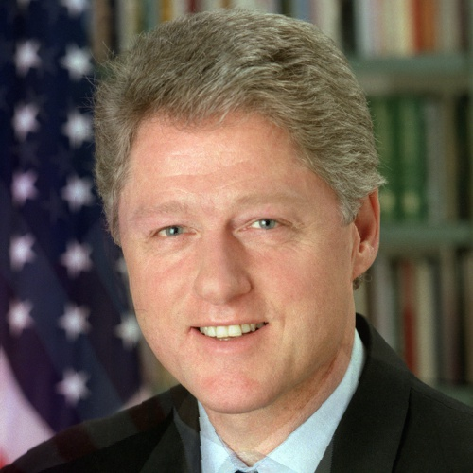
16th Frame

Slide 24
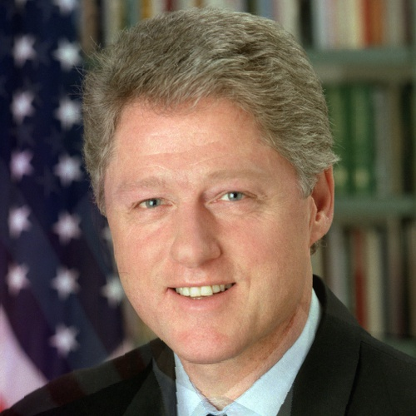
17th Frame

Slide 25

18th Frame

Slide 26

19th Frame

Slide 27

20th Frame

Slide 28

21st Frame

Slide 29
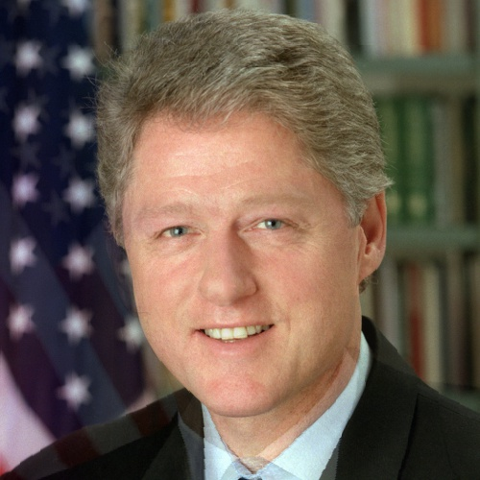
22nd Frame

Slide 30
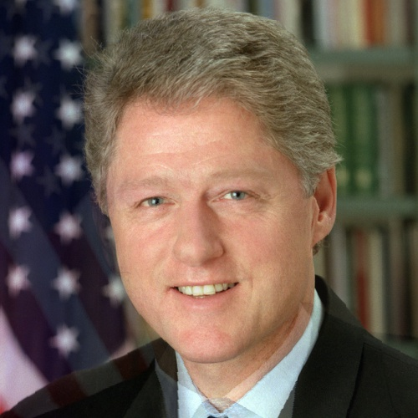
23rd Frame

Slide 31

24th Frame

Slide 32

25th Frame

Slide 33

26th Frame

Slide 34

27th Frame

Slide 35

28th Frame

Slide 36

29th Frame

Slide 37

30th Frame

Slide 38

31st Frame

Slide 39

32nd Frame

Slide 40

33rd Frame

Slide 41
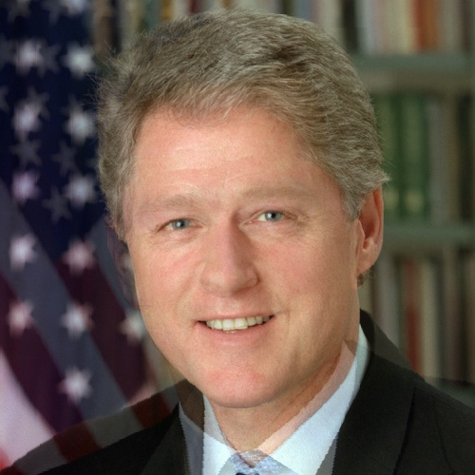
34th Frame

Slide 42

35th Frame

Slide 43

36th Frame

Slide 44

37th Frame

Slide 45

38th Frame

Slide 46
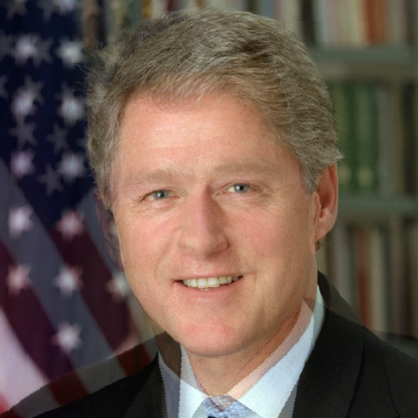
39th Frame

Slide 47

40th Frame

Slide 48

41st Frame

Slide 49

42nd Frame

Slide 50

43rd Frame

Slide 51
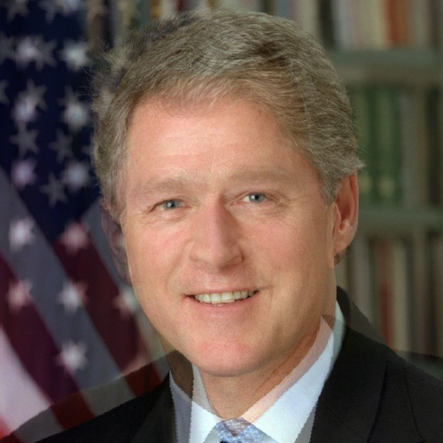
44th Frame

Slide 52
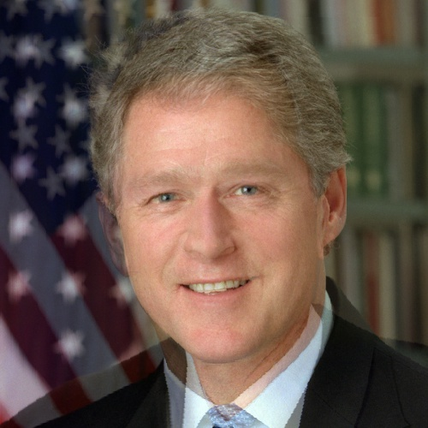
45th Frame

Slide 53
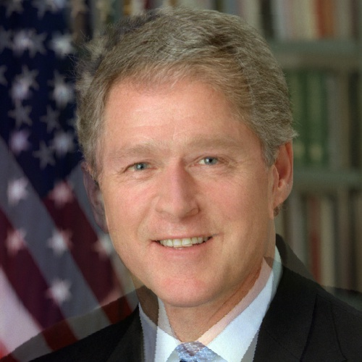
46th Frame

Slide 54

47th Frame

Slide 55
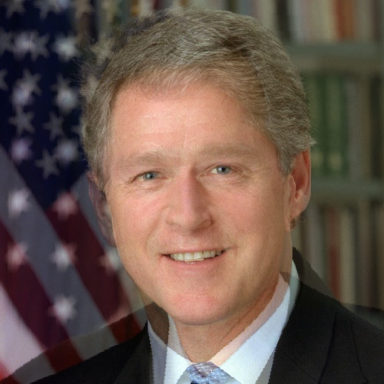
48th Frame

Slide 56

49th Frame

Slide 57

50th Frame

Slide 58
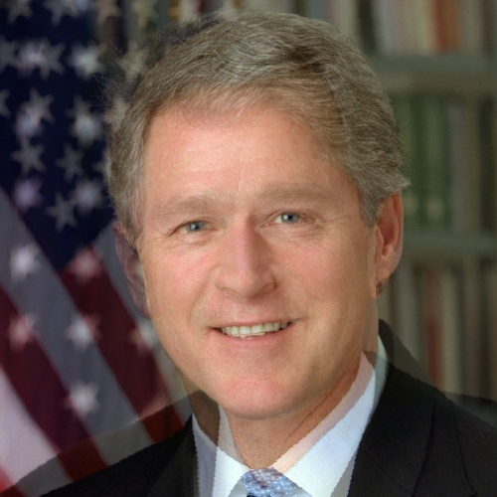
51st Frame

Slide 59

52nd Frame

Slide 60

53rd Frame

Slide 61

54th Frame

Slide 62

55th Frame

Slide 63

56th Frame

Slide 64

57th Frame

Slide 65

58th Frame

Slide 66

59th Frame

Slide 67
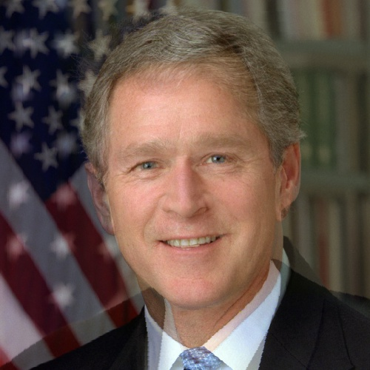
60th Frame

Slide 68

61st Frame

Slide 69

62nd Frame

Slide 70

63rd Frame

Slide 71

64th Frame

Slide 72

65th Frame

Slide 73
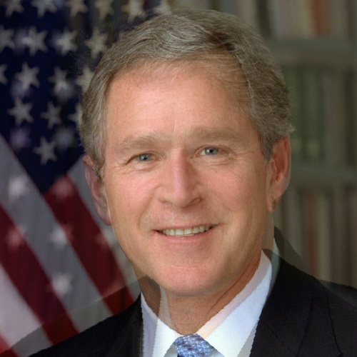
66th Frame

Slide 74

67th Frame

Slide 75

68th Frame

Slide 76

69th Frame

Slide 77

70th Frame

Slide 78

71st Frame

Slide 79

72nd Frame

Slide 80

73rd Frame

Slide 81

74th Frame

Slide 82
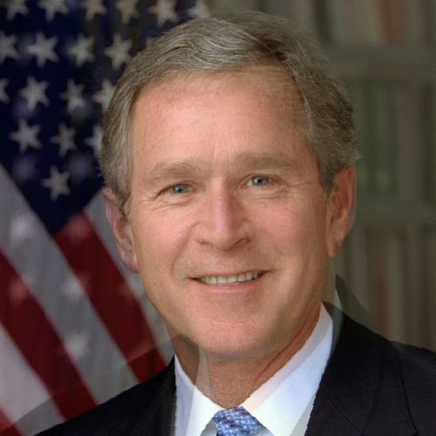
75th Frame

Slide 83
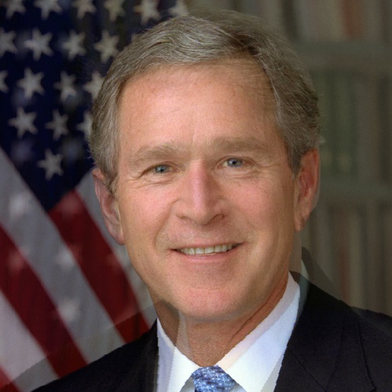
76th Frame

Slide 84

77th Frame

Slide 85

78th Frame

Slide 86

79th Frame

Slide 87

80th Frame

Slide 88
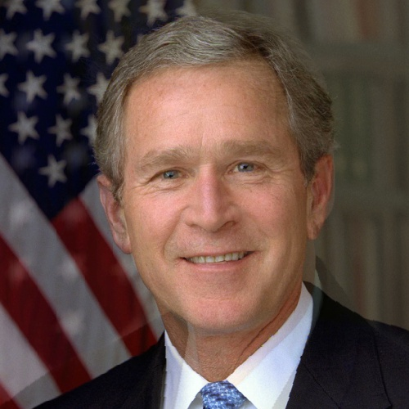
81st Frame

Slide 89
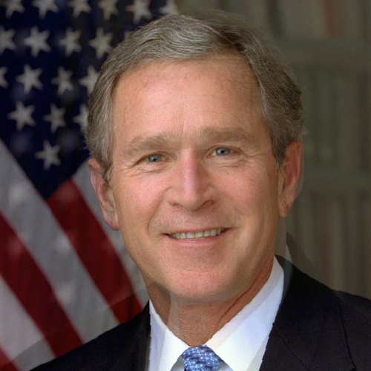
82nd Frame

Slide 90

83rd Frame

Slide 91

84th Frame

Slide 92

85th Frame

Slide 93

86th Frame

Slide 94

87th Frame

Slide 95

88th Frame

Slide 96

89th Frame

Slide 97
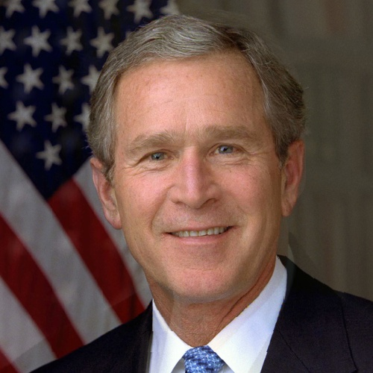
90th Frame

Slide 98

91st Frame

Slide 99

92nd Frame

Slide 100

93rd Frame

Slide 101

94th Frame

Slide 102

95th Frame

Slide 103

96th Frame

Slide 104

97th Frame

Slide 105

98th Frame

Slide 106

99th Frame

Slide 107

100th Frame – Final Image

